Slide 1
Tools for Effective K-5 Literacy Instruction

Slide 2
Research
Policy
Improving reading through science
Practice
Notes:
At the Florida Center for Reading Research, it is our goal make sure all learners are reading and succeeding in school. To do that, we advance research that can inform policy and practice AND we use policy and practice to inform our research. Our bi-directional approach to engaging with educators, leaders, families, and communities helps close the ”research-to-practice divide” so that all children are reading.
This year is also extra special as we celebrate FCRR’s 20th anniversary!

Slide 3
News You Can Use!
Aligned to Florida’s B.E.S.T. K-5 ELA Standards, FCRR has designed a suite of resources to facilitate and enhance literacy instruction.
These tools are ready to use in your classrooms today!
Student Center Activities
Teacher Resource Guide
Reading Centers Information
Essentials for Reading Success Website
Notes:
In partnership with the Florida Department of Education, FCRR has developed a suite of resources to facilitate and enhance literacy instruction in your classrooms. Updates to the Student Center Activities, New and Improved Teacher Resource Guide complete with videos, Reading Centers Information, and a brand-new Essentials for Reading Success website are just some of the many resources we have been working on for you. We are going to review all these resources today!

Slide 4
Session Objectives
Understand the purpose for the resources.
Be familiar with the resources
Know where to find the resources.
Know how to access the resources.
Know how to utilize the resources.
Notes:
We will make sure before you leave this session today that you know where to find, how to access, and how to utilize our resources.

Slide 5
FCRR's Student Center Activities
Notes:
In partnership with the Florida Department of Education, FCRR has revamped and revised our full suite of K- 5 Student Center Activities. We have also aligned them (or at least as many as we could) to the new B.E.S.T. standards, including a filtering tool to assist teachers with matching activities to specific standards. Let’s take a look.

Slide 6
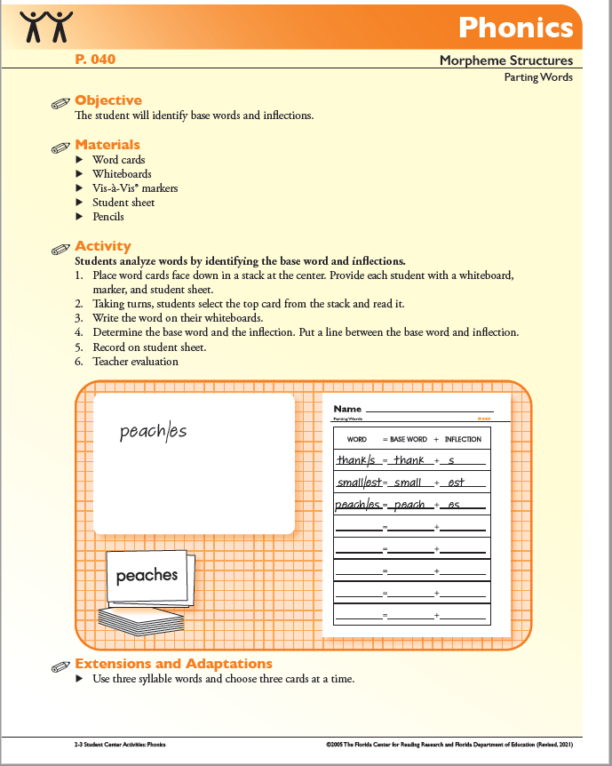
Student Center Activities (SCAs)
FCRR Student Center Activities | Florida Center for Reading Research
Include critical skills that consistently relate to reading success.
Organized by five components of reading: phonological awareness, phonics, fluency, vocabulary, and comprehension.
Designed for teachers to use when implementing student centers.
Systematically designed and intended to be explicitly taught.
Notes:
From 2004 to 2010, a team of researchers and teachers at FCRR collected ideas and created Student Center Activities for use in pre-kindergarten through fifth grade classrooms. The activities are designed for students to practice, demonstrate, and extend their learning of what has already been taught, sometimes with teacher assistance and sometimes independently. Students can complete the activities in small groups, pairs, or individually. Student Center Activities are not intended to be a curriculum. The SCAs are a resource to supplement your curriculum or program of choice. Although the SCAs are organized sequentially, assessment results should guide the teacher’s decision regarding activity selection and the timeline for implementation.

Slide 7
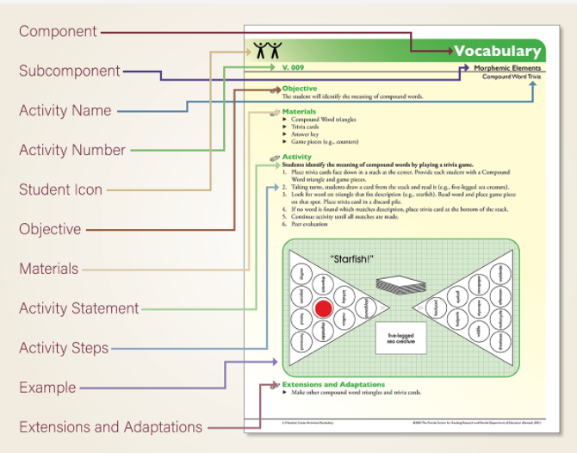
Notes:
Let’s breakdown how to read a student center activity:
COMPONENT Name of the reading component: Phonological Awareness (PA), Phonics (P), Fluency (F), Vocabulary (V), or Comprehension (C). Each component is color coded: PA is purple, P is orange, F is red, V is green, C is blue.
SUBCOMPONENT Name of the reading subcomponent, which is a subskill of the component.
ACTIVITY NAME Name of the activity.
ACTIVITY NUMBER The letters correspond with the reading component (PA, P, F, V, or C). The numbers are listed in ascending order within each component. The activities are sequenced from simple to more complex within each component and subcomponent.
STUDENT ICON The suggested number of students for the activity. One student icon indicates that students may work independently or with a small group. Two student icons indicate that the activity requires students to work in pairs. Two student icons with a plus sign indicate that the activity requires two or more students.
OBJECTIVE States the goal of the activity, which is aligned with the subcomponent.
MATERIALS Materials are located on the pages that follow the Activity Plan. Most materials are non-consumable to be prepared and used repeatedly (e.g., word cards can be laminated). Some materials are consumable and will need to be duplicated for each student doing the activity. Other materials, such as counters, are commonly found in most classrooms.
ACTIVITY STATEMENT One sentence explanation of the purpose of the activity and what students do to complete the activity.
ACTIVITY STEPS The first step describes how to setup the center. The second step begins with: The student, Students, Working in pairs, or Taking turns depending on the number of students needed to complete the activity. The second step also starts the series of steps to complete the activity. The next steps explain what the student does to complete the activity. The last step lists one of three accountability methods: Self-check, Peer evaluation, or Teacher evaluation.
EXAMPLE A visual of the activity and key materials.
EXTENSIONS AND ADAPTATIONS Suggestions that extend or provide an adaptation for additional practice on the skill addressed in the activity. Materials for the extensions and adaptations are included after the pages that align to the Activity Plan.

Slide 8
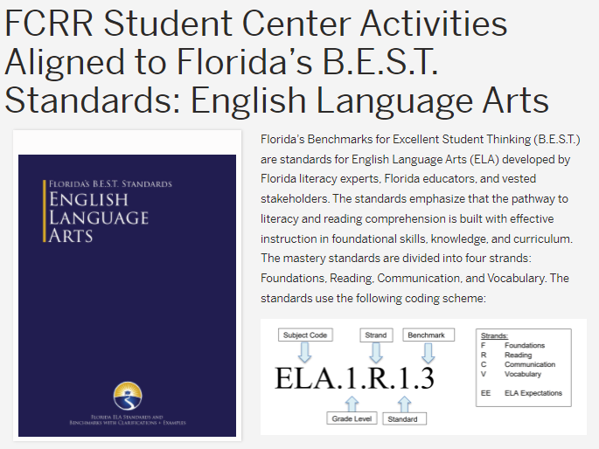
Student Center Activities – B.E.S.T Alignment
FCRR Student Center Activities Aligned to Florida’s B.E.S.T. Standards: English Language Arts | Florida Center for Reading Research
Notes:
In 2021 and early 2022, in partnership with the Florida Department of Education, FCRR updated and revamped all K-5 Student Center Activities. All the materials needed for each SCA is included in one PDF—so no need to go to another SCA/source. Many of the SCAs have been aligned with Florida’s B.E.S.T English Language Arts Standards.

Slide 9
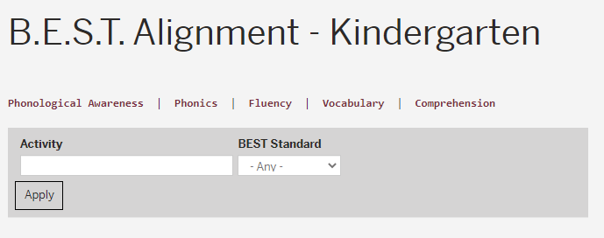
Student Center Activities – B.E.S.T. Alignment Filtering Tool
B.E.S.T. Alignment - Kindergarten | Florida Center for Reading Research (fcrr.org)
Notes:
FCRR also created a filtering tool to use with the aligned Student Center Activities. The filtering tool allows users to find activities by grade, standard, and/or area of reading instruction in grades K-5.
**show how this works online (big screen). Tie the slides 6 – 9 together with demonstration.

Slide 10
Teacher Resource Guide

Slide 11
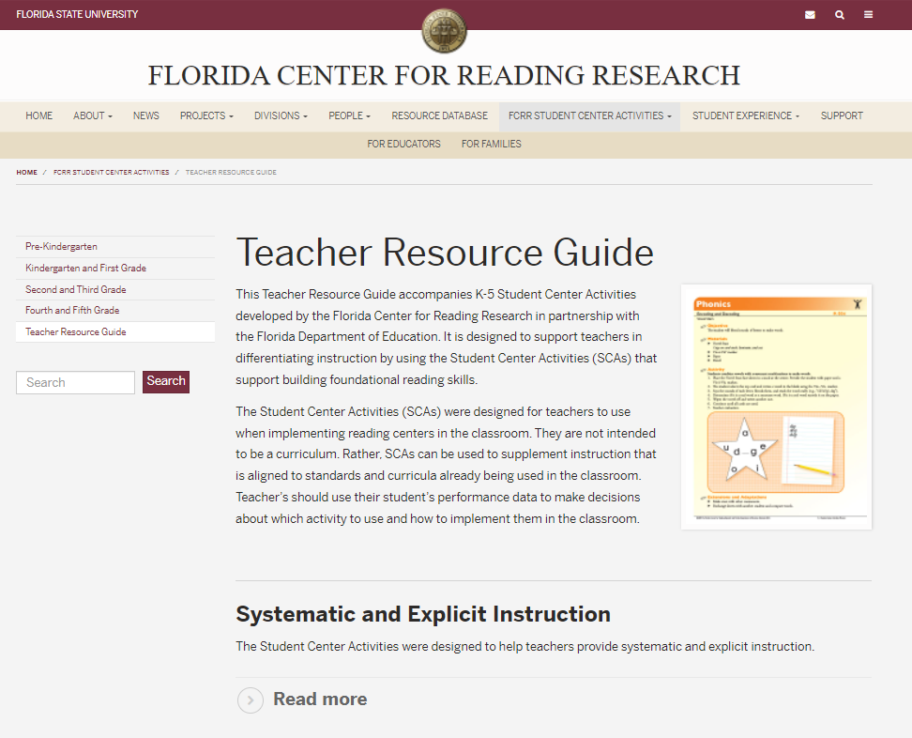
Teacher Resource Guide
Teacher Resource Guide | Florida Center for Reading Research (fcrr.org)
Accompanies K-5 Student Center Activities.
Designed to support teachers in differentiating instruction in foundational reading skills.
Notes:
The teacher resource guide accompanies the K-5 Student Center Activities. It is designed to support teachers in differentiating instruction by using the SCAs to support building foundational reading skills. The teacher resource guide is divided into various sections, including information about reading centers complete with demonstration videos, definitions of terms, and examples of sequential skills across the five components of reading instruction.

Slide 12
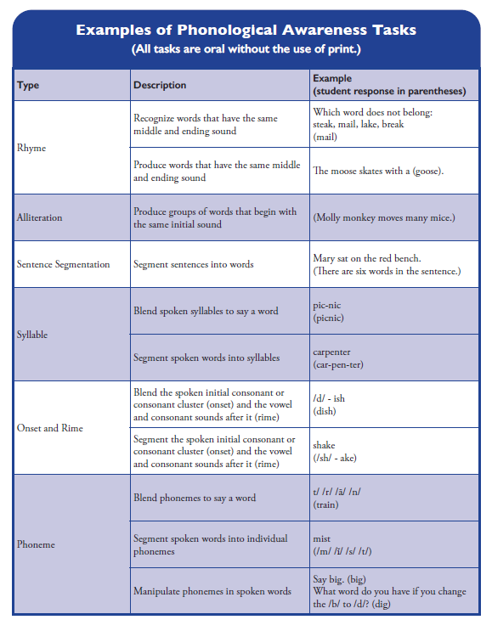
Five Components of Reading Instruction
The Student Center Activities (SCAs) include critical skills that consistently relate to reading success and are organized by five components of reading instruction:
phonological awareness
phonics
fluency
vocabulary
comprehension
Notes:
For each of these five components of reading, there is a definition and why it is important included in the Teacher Resource Guide. There are also resources that correlate with Phonological Awareness, Phonics, and Vocabulary.

Slide 13
Sequence of the Phonological Awareness SCA’s
Across Grade Levels
Progress monitoring data and teacher observation determine the order of SCA implementation and who engages in which SCA.
Below is the sequence, from simple to complex, of the subcomponents of the phonological awareness activities across the grade levels.
Notes:
The Teacher Resource Guide also includes the sequence, from simple to complex, of each sub-component of reading across grade levels. Here is an example of of the sequence for phonological awareness.

Slide 14
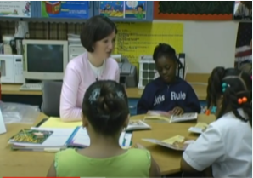
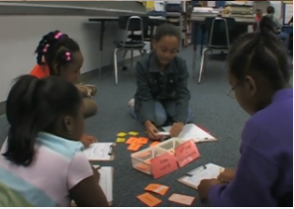
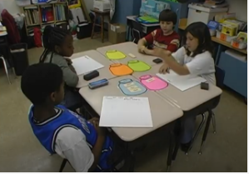
Teacher Resource Guide - Reading Centers
The Student Center Activities are designed to be delivered in reading centers. The teacher resource guide provides a wealth of information on the design and implementation of reading centers, including:
What are reading centers?
How to set up reading centers.
How to implement reading centers using the student center activities.
Differentiated instruction.
Systematic and Explicit instruction.
Notes:
The Reading Centers material is designed to provide instruction information to all teachers, both novice and veteran. This is a good refresher for those who know…and a nice introduction to those who need additional support.

Slide 15
What are Reading Centers?
Center Spaces – YouTube
Center Locations – YouTube
Places where students practice, demonstrate, and extend learning independent of the teacher or with the assistance of the teacher.
Organized in the classroom for students to work in small groups, pairs, or individually.
Meaningful, purposeful activities that are a reinforcement and/or extension of what has already been taught by the teacher in reading groups or in whole group.
Focus on and reflect the content of reading instruction and require careful planning.
Notes:
In these short video clips, teachers explain and give examples of how they find space in their classrooms for centers, and the preference of having centers in the same spaces or rotating them around the room.

Slide 16
What is Differentiated Instruction?
Matching instruction to each student’s individual needs and abilities.
Accomplished by teacher working with an individual student or with small group of students.
Implementing reading centers is an effective way to differentiate instruction; providing time for teacher to meet diverse instructional needs of all students.

Slide 17
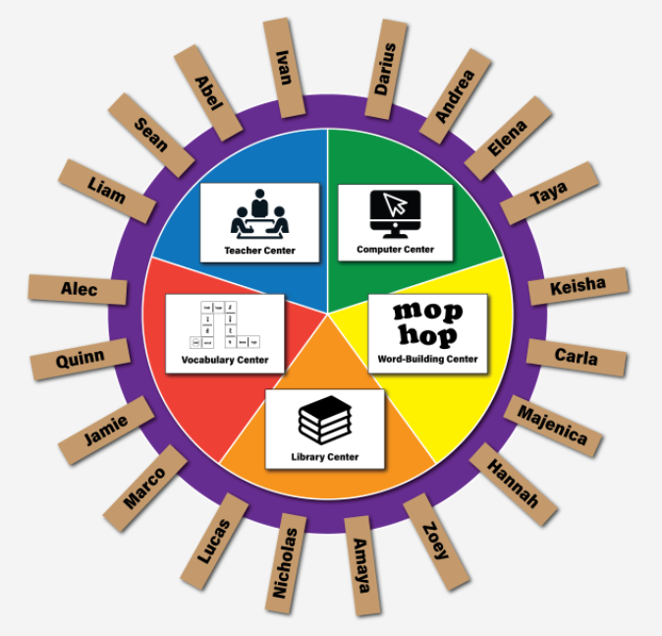
Implementing Reading Centers Using Student Center Activities
Elements for successfully implementing reading centers:
Form flexible groups based on assessment
Select activities based on assessment
Design a center management system
Provide explicit instruction
Implement a behavior management system
Organize the Classroom
Manage transition
Use accountability
Notes:
Implementing the SCAs in a well-managed classroom allows the teacher to differentiate instruction in small groups. Each SCA is explicitly taught before students use them independently.
These 8 elements can assist teachers in implementing reading centers in the classroom. This picture shows an example of a center management system. Examples of other types of center management systems include pocket charts with student pictures, or file folders with student names.

Slide 18
Implementing Reading Centers Using the Student Center Activities
Providing Explicit Instruction – Demo Videos
1. Teacher Models and Explains the Activity 2. Teacher Provides Guided Practice
Grades 2-3 P.031 Syllable Snake
Grades 2-3 P.031 Syllable Snake
Notes:
Explicit Instruction includes instructional routines that consist of teacher modeling, guided practice, supported application, and independent practice. Here is a video that shows a teacher implementing explicit instruction using the Student Center Activity, Syllable Snake. First, she models, then she provides guided practice. This activity is from the second and third grade SCAs.
Show videos.

Slide 19
Implementing Reading Centers Using the Student Center Activities
Providing Explicit Instruction – Demo Videos
3. Teacher Provides Supported Application 4. Independent Practice
Grades 2-3 P.031 Syllable Snake
Grades 2-3 P.031 Syllable Snake
Notes:
To continue explicit instruction, the teacher provides supported application. Finally, once the teachers understand the skill and activity, she provides opportunities for independent practice.
Show videos.

Slide 20
Student Center Activities
Interactive Digital Games
(forthcoming)

Slide 21
Notes:
FCRR is in the process of developing digital games using our Student Center Activities. Teachers will be able to select activities by grade level, topic, or activity name.

Slide 22
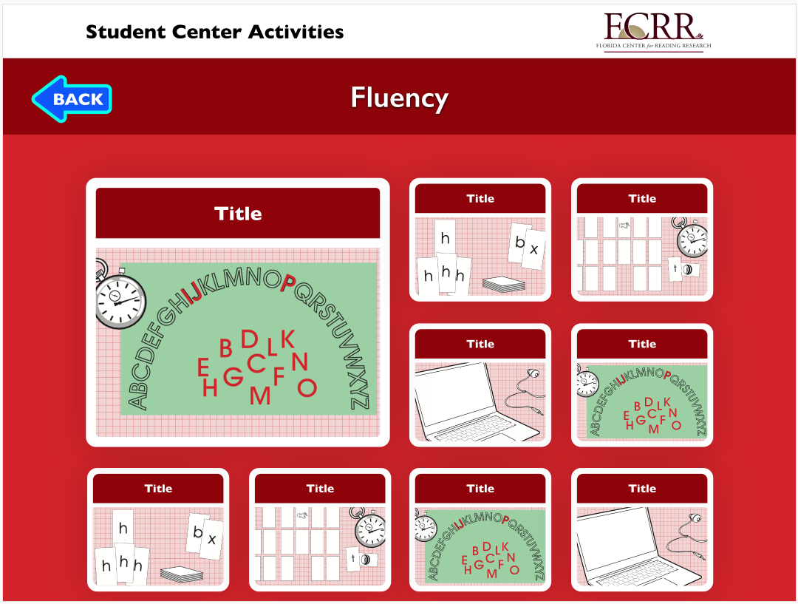
Notes:
This is a preview of the site and how a game will look online.

Slide 23
Essentials for Reading Success Website
Notes:
We developed a new website call Essentials for Reading Success and are excited to share it with you!

Slide 24
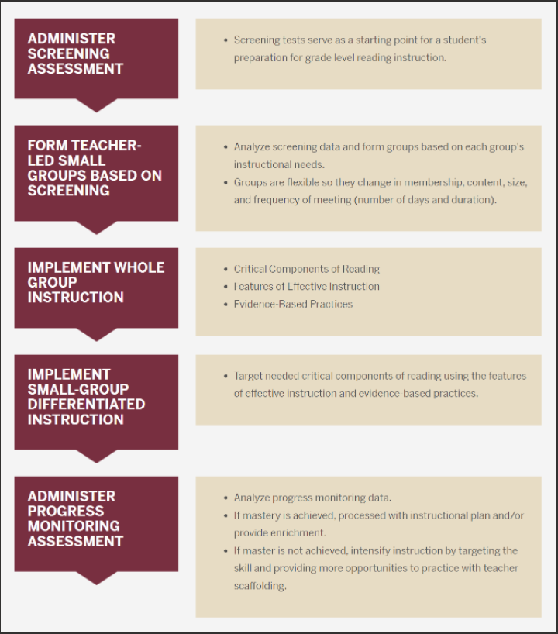
Essentials for Reading Success Website
Essentials for Reading Success uses data from assessments, and incorporates response to intervention, the features of effective instruction (including differentiated instruction), and evidence-based practices to teach the critical components of reading.
Notes:
The ESSENTIALS FOR READING SUCCESS website was designed to provide K-3 educators support in understanding and using scientifically based reading instruction in their classrooms. ESSENTIALS FOR READING SUCCESS shares information about using data from assessments, and incorporates response to intervention, the features of effective instruction (including differentiated instruction), and evidence-based practices to teach the critical components of reading.
**add link to webpage once available.

Slide 25
Assessments to Inform Instruction
Notes:
The assessment section of this website over views three types of formative assessments that are typically used to inform instruction: screening, progress monitoring, and formative diagnostic tests. It includes this table that describes each assessment including when to administer it, who administers it, and questions that are answered by the assessment.

Slide 26
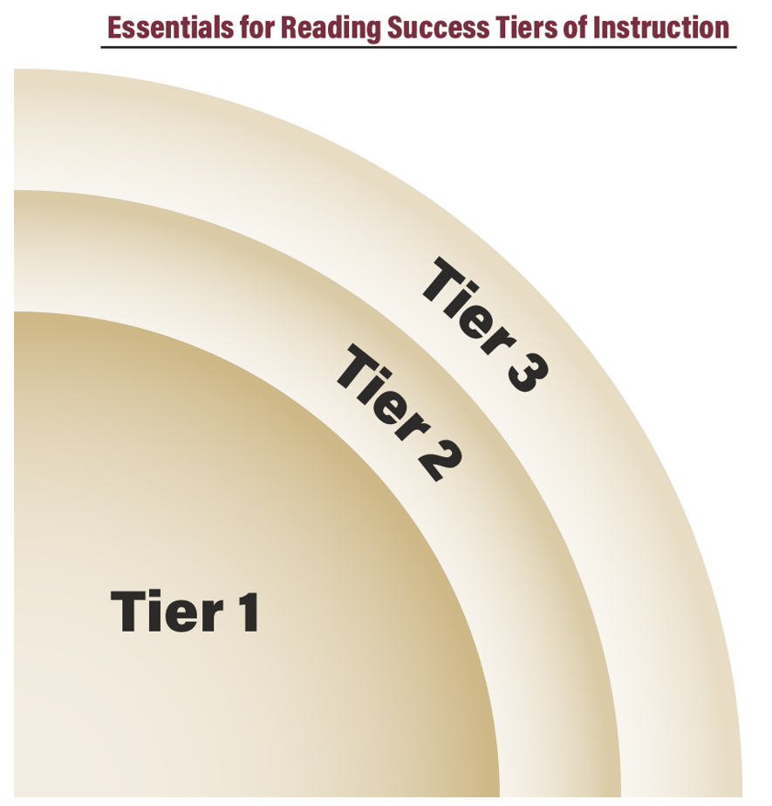
Response to Intervention - Overview
Notes:
There is also a Response to Intervention section that describes the three tiers of instruction. There are also short videos about RtI.

Slide 27
Notes:
Another section of the Essentials for Reading Success website describes the features of effective instruction that work in combination and are the basis of high-quality reading instruction. Effective instruction includes a scope and sequence and is systematic, explicit, scaffolded, and differentiated. This infographic provides a definition, overview, and characteristics of each feature of effective instruction.

Slide 28
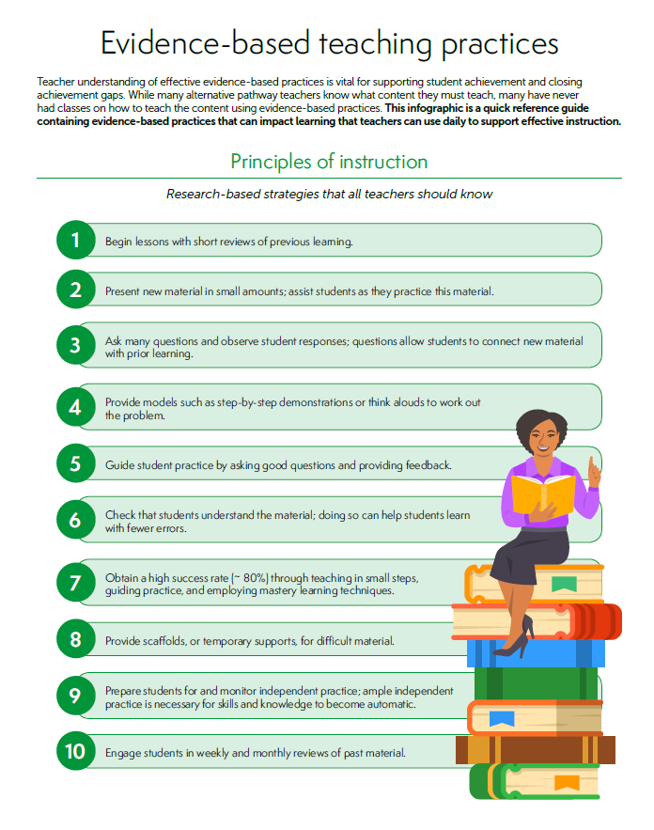
Differentiated Instruction Overview
Notes:
There is also an overview of differentiated instruction and information about evidence-based practices, including this infographic. This is a quick reference guide containing evidence-based practices that can impact learning that teachers use daily to support effective instruction.

Slide 29
Components of Reading - Overview
Reading components: oral language, phonological awareness, phonics, fluency, vocabulary, comprehension, and writing.
Definition, why it is important, and evidence-based practices and resources.
Information to support differentiated instruction:
-Grade-specific Student Progress Records
-Questions to Guide Instruction
-Instructional Routines
Notes:
The bulk of the Essentials for Reading website includes information about the components of reading: oral language, phonological awareness, phonics, fluency, vocabulary, comprehension, and writing. For each reading component, you will find a definition, why it is important, and evidence-based practices and resources.
Also included is information to support differentiated instruction:
-Grade-specific Student Progress Records
-Questions to Guide Instruction
-Instructional Routines

Slide 30
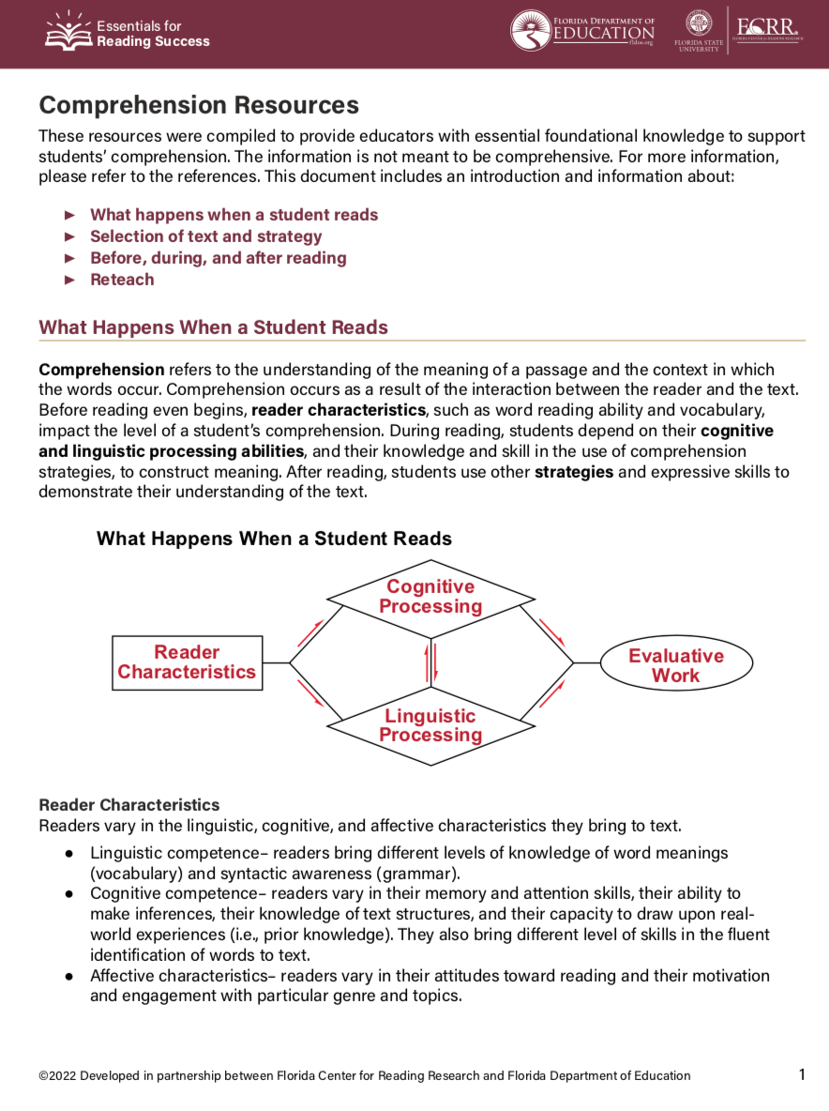
Resources for each component of reading are included in the Essentials for Reading Success website.
Notes:
Resources for each component of reading were compiled to provide teachers with essential foundational knowledge to support students’ reading development. Here is the comprehension resource. This document includes an introduction and information about
What happens when a student reads
Selection of text and strategy
Before, during, and after reading
Reteach

Slide 31
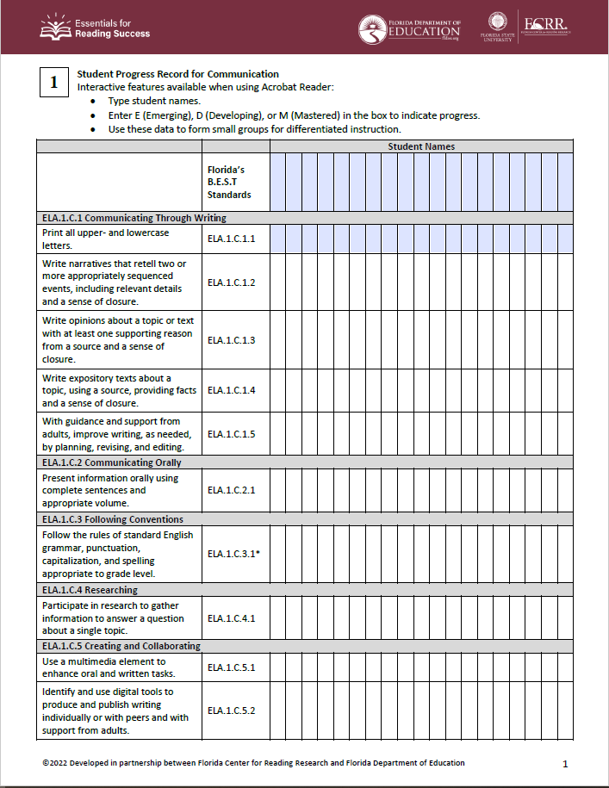
Student Progress Records
Aligned to the B.E.S.T. ELA Standards, these Student Progress Records can be used to record individual student progress and to form groups for differentiated small group instruction.
They can also be completed digitally as a fillable PDF.
Notes:
**demo how this works in presentation
**need to replace graphic once we have the final one.

Slide 32
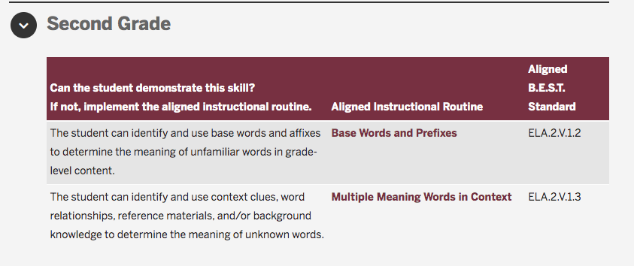
Information to Guide Instruction and Instructional Routines
The Information to Guide Instruction and associated Instructional Routines are specific to each grade level and reading component.
Notes:
Understanding the components of reading in which the students need extra support or enrichment is vital in the overall academic success of the student. The Information to Guide Instruction can help you learn more about the needs of your students and guide your instruction with specific groups and/or individual students.
For example, the information in this second-grade table for vocabulary can help you learn more about the instructional needs of your students and guide your instruction with specific groups and/or individual students. If the student cannot demonstrate the skill, you can implement the aligned instructional routine during small group instruction. Each instructional routine is also aligned to a BEST standard.

Slide 33
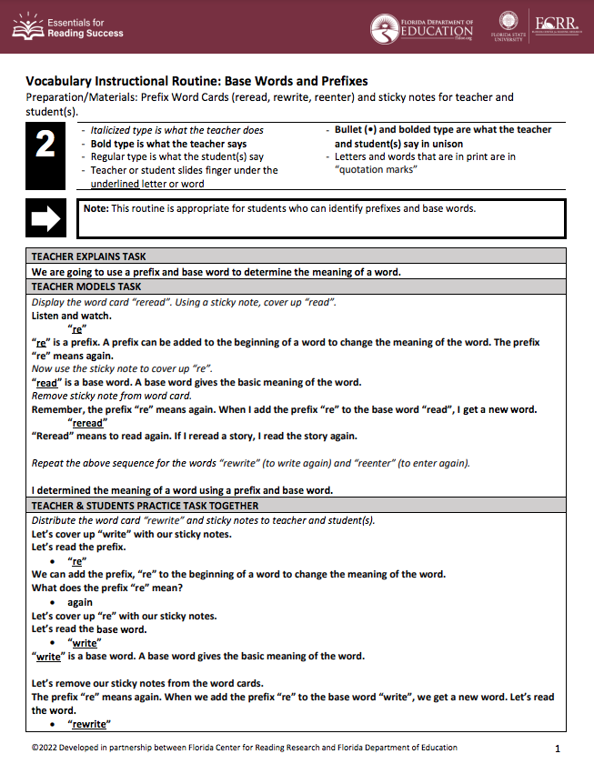
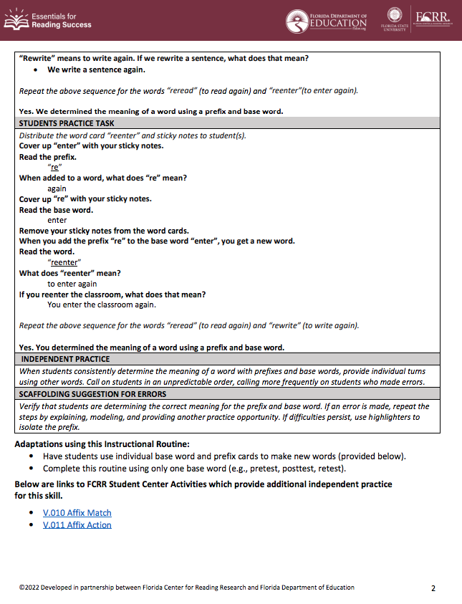
Notes:
This is an example of a 2nd grade instructional routine for Vocabulary. Notice there are links on the last page that take you directly to a Student Center Activities that highlight the skill in this routine.

Slide 34
Notes:
Any questions for us?

Slide 35
Thank you!
jgans@fcrr.org
jbaisden@fsu.edu

